Slide 1
Cocaine Enchained
Global Commodity Circuits, 1890s-1930s

Slide 2
What is….
A commodity chain?
A global commodity chain?

Slide 3
For sociologists….
It is an analytical tool that considers goods in the light of their “global connectedness.”
Used to trace the social and spatial networks that connect distant producers of commodities all the way through intermediaries and to consumers.
Bring together the entire process of what we now call “globalization.”
But more than just the flow of goods: Commodity chains can be broadened conceptually to show how movements of goods are accompanied and facilitated by flows of culture, science, politics, prestige, and other exchanges.
Goods can thus “possess deeper and often hidden relational histories and meanings.”

Slide 4
This appears to be the story for cocaine….
Can we apply this concept to other things?
Other illegal things?
Legal things?

Slide 5
The example of jeans….
The material for the jeans is harvested in Kazakhstan before it is manufactured into yarn in Turkey.
After that step it is shipped to Taiwan for coloring, before it is weaved in Poland.
France delivers materials like buttons and rivets.
All components are shipped to the Philippines for sewing.
Final processing takes place in Greece, before the final pair of jeans are sold, for example, in the United States.

Slide 6
The German-Andean Connection
We’ve already seen this at play….
But perhaps too successful?
“with world production in excess of fifteen metric tons by the early 1900s, medicinal markets were saturated and began to leak into nonmedical exports and uses.”
May help us make better sense of….

Slide 7
The U.S.-Andean Chain
In 1900, American’s were the world’s largest, most avid consumers and boosters of both coca and cocaine, “by then seemingly domesticated, all-American goods.”
By 1910, however, American attitudes and policies had turned against these goods. Just ten years later a push to banish them was gaining steam.
“In the broadest perspective, U.S. relationships to coca must be seen as a part of expanding informal U.S. influence in the Andean region.”

Slide 8
The appeal of coca in the United States….
Was non-medical – more romantic.
The therapeutic value of the herbal coca leaf….
Coca-Cola and other such products.
And many who romanticized the coca leaf:
“Among the books that interested me in those days was one about the Amazon… [H]e told an astonishing tale about coca, a vegetable product of miraculous powers, asserting that it was so nourishing and so strength-giving that the native of the mountains of the Madeira region would tramp up hill and down all day on a pinch of powdered coca and require no other sustenance. I was fired with a longing to ascend the Amazon. Also with a longing to open up a trade in coca with all the world. During months I dreamed that dream, and tried to contrive ways to get to Para and spring that splendid enterprise upon an unsuspecting planet.”

Slide 9
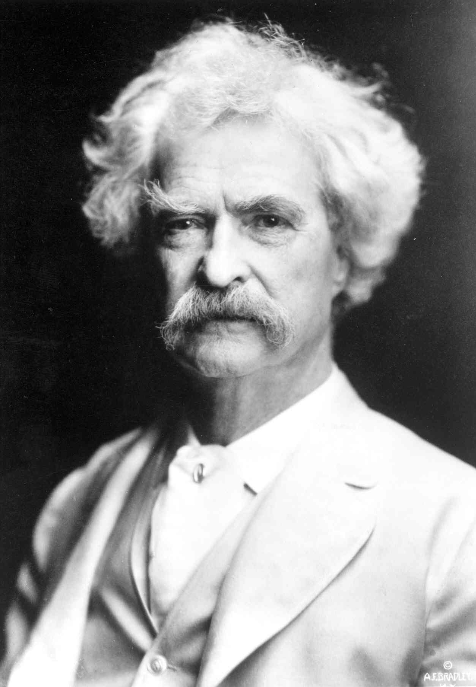
Mark Twain

Slide 10
By the early 1900s….
Americans imported six hundred to a thousand metric tons of coca annually, mainly for such popular markets.
Because of this, the United States “actively promoted initial Andean coca trades and left an early mark there.”
Parke, Davis sent its company ethnobotanist on vital coca missions.
The U.S. Navy, in cooperation with the surgeon general and consuls in Peru, worked to identify and secure coca supply routes from the Andes.

Slide 11

Parke, Davis today?

Slide 12
A subsidiary of Pfizer….
One of most powerful pharmaceutical companies in the world.
Revenue of $52 billion in 2013.

Slide 13
Global Coca Under Pressure, 1905-1910
As the product became popular in countries across the globe (including India, Holland, France, Germany, Russia, England, Chile, Cuba, and the United States) it began to set off panics.
This was particularly true in American cities, where – as we have already seen – use of cocaine came to be associated with certain types of people.
What was the story here?
Leads to a questioning of how product should – or shouldn’t – be used.

Slide 14
Divvying Up Global Coca, 1910-1950
“The four decades after 1910 represent cocaine’s declining middle age between the drug’s licit peak and its global source- and end-market prohibition after 1950.
From production of more than fifteen tons in 1905, global use likely halved by 1930.
By 1950, the United Nations set legal world medicinal needs for cocaine at under two metric tons.

Slide 15
What brought about this fall?
A narrowing of medical usage due to newly discovered alternative anesthetics and to changing medical opinion.
Anticocaine laws and campaigns by states and other international bodies.
Market retreat and diversification on the part of vulnerable cocaine makers and coca planters.

Slide 16
In the United States….
The largest consumer market for cocaine, initiated trade restrictions with the 1906 creation of the Food and Drug Administration.
1914 Harrison Act (which we discussed last week).
Instituted a fully operative import control system by 1922.
As it became a world leader, it pushed for global cocaine controls at the Hague Conventions of 1912-14 and successive Geneva-based League of Nations conventions after 1924.

Slide 17
This leads to….
The International Opium Convention, signed at The Hague on January 23, 1912 during the First International Opium Conference.
This was the first international drug control treaty.
The treaty was signed by Germany, the United States, China, France, the United Kingdom, Italy, Japan, the Netherlands, Persia, Portugal, Russia, and Siam.
The Convention provided that "The contracting Powers shall use their best endeavours to control, or to cause to be controlled, all persons manufacturing, importing, selling, distributing, and exporting morphine, cocaine, and their respective salts, as well as the buildings in which these persons carry such an industry or trade."

Slide 18
Yet rather than vanish….
Cocaine divided into a trio of politically constructed and geographically segmented global commodity chains.
The first?

Slide 19
The Dutch Colonial Coca Boom, 1905-1930
Rooted in Dutch Java, which is now part of Indonesia.
Pliable cheap Javanese field labor, an easier plantation geography near to shipping, four annual handpicked harvests of young leaves, economies of scale, technical rationalization, rotation, and intercropping with colonial rubber and tea projects all helped Javan efficiency surpass the Andes.
By 1911, some 44 plantations captured a quarter of the world coca market, making Amsterdam into the world’s most active coca marketplace.
The global trade disruptions of World War I brought even more European reliance on this coca corridor.

Slide 20
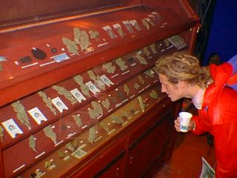
Amsterdam today?

Slide 21
By 1920….
Javan coca basically satisfied the whole of world cocaine demand, estimated at twelve tons.
But this started to clash with evolving international norms – and the Dutch wanted to be a part of the legitimate global economy.
Also not helping was the Japanese invasion of Java during World War II – this “mortally disrupted” the corridor.

Slide 22
Interestingly….
It was Japan itself that filled the void, with the rise of “Japanese Imperial Cocaine.”
By the 1930s, Japan was one of the largest producers and purveyors of cocaine to east and south Asia.
A transnational occurrence, involving individuals and companies from the United States, the Netherlands, and Germany.

Slide 23
Why Japan?
Starting during World War I, Japan sought self-sufficiency in the face of disrupted trades, and close relations of the state with large firms was a basic feature of Japanese business culture.
The development of an integrated pharmaceuticals industry represented an important sign of scientific modernization.
“For Japan, drug exports were a normal and necessary business.”
By 1920, Japan itself produced more than four thousand pounds of cocaine a year – doubled to eight thousand pounds by 1922.
Continued through the 1930s.
What brings it to a halt?

Slide 24
The U.S.-Andean Chain, 1910-1950
“The U.S.-Andean chain, despite these rivals and its own commercial decline, proved the most resilient and decisive in the long-term histories of coca and cocaine.”
Formal vs. informal? This chain operated “within an expanding informal American sphere.”

Slide 25
Fueling the growth of this chain….
Was non-medicinal use of coca:
By World War II, the United States consumed twice as much coca in beverages – more than two hundred thousand kilos annually – than was used in making residual medicinal cocaine, which had fallen to under a thousand kilos a year.
Coca-Cola sold its cocaine residue to Merck.
“In effect, all American cocaine became a by-product of the Coca-Cola chain, or empire.”

Slide 26
But a sense that World War II….
Was the end of an era.
During the war, the United States – itself emerging as a true superpower (the start of the “American Century”) – closed Peru’s outlets to Japan and Germany.
“Cocaine’s most modern circuits, those with high-tech plantations and large factories, were destroyed once and for all.”

Slide 27
Into the Cold War….
What defined this moment in history?
For the US?
For Latin America?

Slide 28
In Peru…..
A desire to appease the United States.
As the US went anti-drug, so did those that wanted to remain in its good graces.
“As an anticoca consensus gathered at the new American-inspired United Nations drug agencies, Peru rushed to outlaw cocaine making in 1947-49….By 1950, the U.S.-Andean commodity chain, born a century before and the last survivor of its kind, came to an end – at least in its licit [legal] market phase.”

Slide 29
What….
Would come next?
And why?

